Slide 1
Gaussian Sampling Based Lattice Decoding
Bragadeesh (EE14B114)
Nived Rajaraman (EE14B040)
Dheeraj.M.Pai (EE14B082)

Slide 2
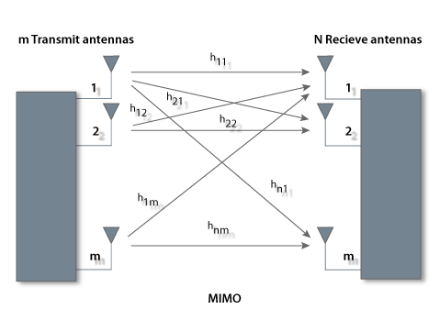
MIMO system

Slide 3
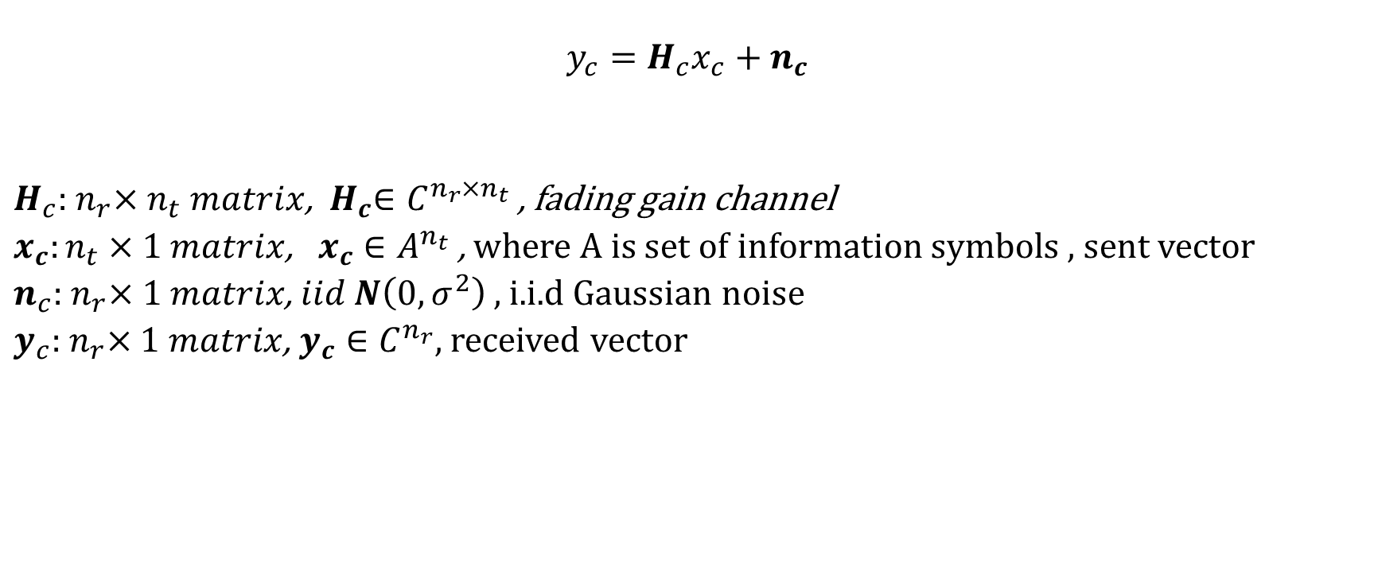
Channel model
$$y_{c}=H_{c}x_{c}+n_{c}$$
$H_{c}:{ n}_{r}×n_{t} matrix$, ${ H}_{c}∈C^{n_{r}×n_{t}}$ , fading gain channel
$x_{c}:n_{t}×1 matrix$, $x_{c}∈A^{n_{t}}$, where $A$ is set of information symbols , sent vector
$n_{c}:{ n}_{r}×1 matrix$, $iid$ $N\left(0,σ^{2}\right)$ , i.i.d Gaussian noise
$y_{c}:{ n}_{r}×1 matrix$, $y_{c}∈C^{n_{r}}$, received vector

Slide 4
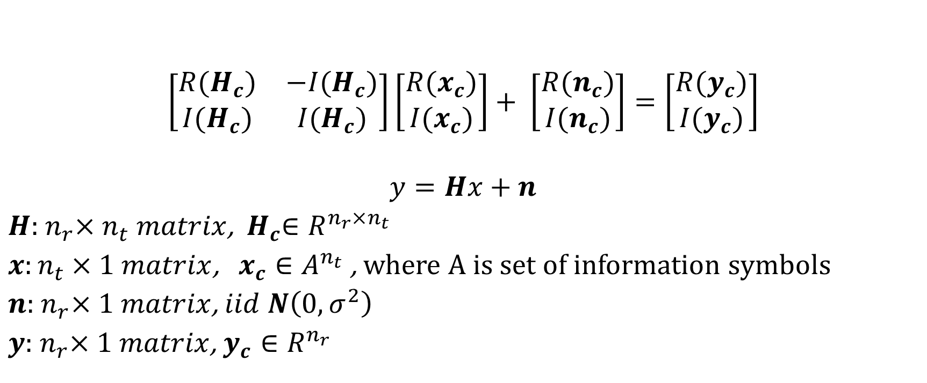
Simplified equation
$$\left[\begin{matrix}R(H_{c}) & −I(H_{c}) \\ I(H_{c}) & I(H_{c})\end{matrix}\right]\left[\begin{matrix}R(x_{c}) \\ I(x_{c})\end{matrix}\right]+ \left[\begin{matrix}R(n_{c}) \\ I(n_{c})\end{matrix}\right]=\left[\begin{matrix}R(y_{c}) \\ I(y_{c})\end{matrix}\right]$$
$$y=Hx+n$$
$H:{ n}_{r}×n_{t} matrix$, ${ H}_{c}∈R^{n_{r}×n_{t}}$
$x:n_{t}×1 matrix$, $x_{c}∈A^{n_{t}}$, where $A$ is set of information symbols
$n:{ n}_{r}×1 matrix$, $iid$ $N\left(0,σ^{2}\right)$
$y:{ n}_{r}×1 matrix$, $y_{c}∈R^{n_{r}}$

Slide 5

The problem
$$y=Hx+n$$
$$x^{̂}={argmin}_{x∈A^{n}}{{\left|\left|y−Hx\right|\right|}^{2}}$$
This is identical to the lattice problem
$$λ\left(L\right)=\min_{v∈L\backslash \{0\}}{|\left|v\right||}$$
which is NP-HARD!!!!! ☹

Slide 6

Lattice decoding algorithm
Assume all entries of $x$ except at index $i$is known
Sample $x_{i}$ randomly from it’s probability distribution
Expected to converge to the optimal solution at infinity
May not give optimal results with negligible probability

Slide 7

Lattice decoding algorithm
$$p\left(x_{i}\right|y,H,x_{j≠i})∝ \exp\left(−\frac{||{y−Hx|\left.​\right|}^{2}}{σ^{2}}\right)∝exp⁡(−\frac{||{x_{i} −μ_{i}|\left.​\right|}^{2}}{σ^{2}/{\left|\left|h_{i}\right|\right|}^{2}})$$
where $μ_{i}=\frac{{\left(y^{i}\right)}^{T}h_{i}}{{\left|\left|h_{i}\right|\right|}^{2}}$, ${ h}_{i}$is $i^{th}$ column of $H$ matrix

Slide 8
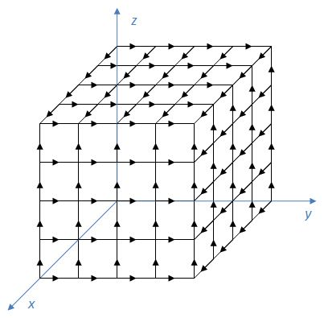
Visualizing GSLD
At next iteration, new coordinate is chosen
from the particular dimension instead of all points.
Conditional distribution along each dimension
is known.
Expected to converge probabilistically to
ML solution

Slide 9
Implementation Specific Details
Discussing pseudo code, computational complexity and convergence

Slide 10
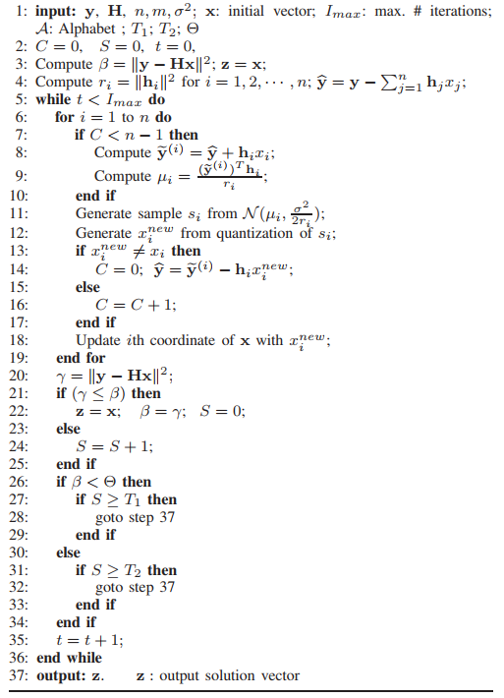
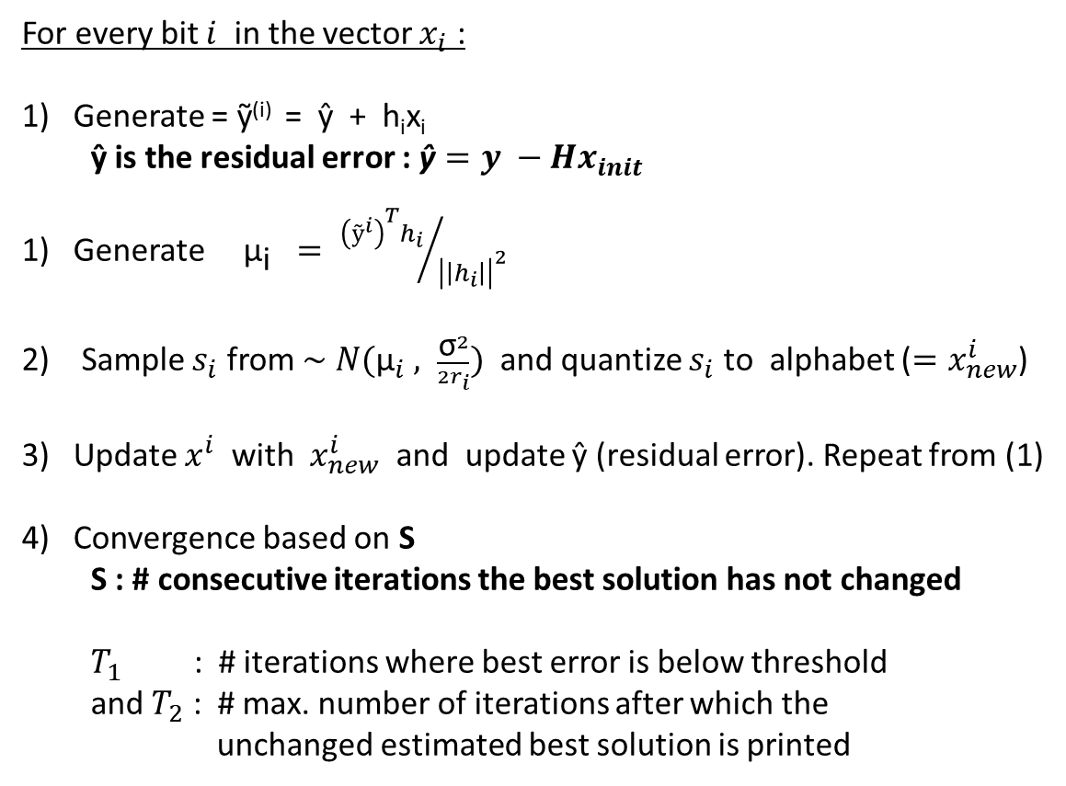
Pseudo code
For every bit $i$ in the vector $x_{i}$ :
Generate = ỹ^{(i)} = ŷ + h_{i}x_{i}
ŷ is the residual error : $\text{ŷ}=y −Hx_{init}$
Generate ${\text{μ}}_{\text{i}} = {{\left(ỹ^{i}\right)}^{T}h_{i}}/{{\left|\left|h_{i}\right|\right|}^{2}}$
Sample $s_{i}$ from ∼ $N({\text{μ}}_{i} , \frac{{\text{σ}}^{2}}{2r_{i}})$ and quantize $s_{i}$ to alphabet ($=x_{new}^{i}$)
Update $x^{i}$ with $x_{new}^{i}$ and update ŷ (residual error). Repeat from (1)
Convergence based on S
S : # consecutive iterations the best solution has not changed
$T_{1}$ : # iterations where best error is below threshold
and $T_{2}$ : # max. number of iterations after which the
unchanged estimated best solution is printed

Slide 11
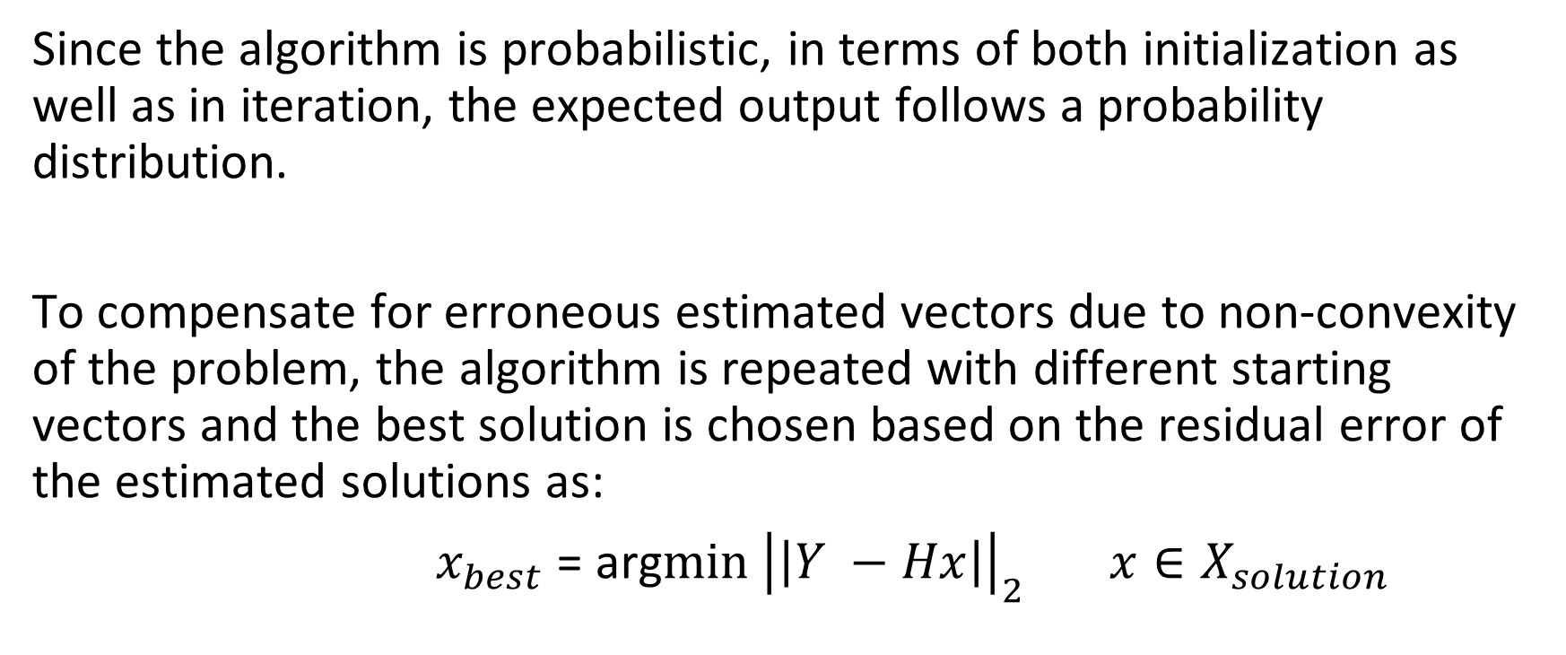
Restarts
Since the algorithm is probabilistic, in terms of both initialization as well as in iteration, the expected output follows a probability distribution.
To compensate for erroneous estimated vectors due to non-convexity of the problem, the algorithm is repeated with different starting vectors and the best solution is chosen based on the residual error of the estimated solutions as:
$x_{best}$ = arg$\min{{\left|\left|Y −Hx\right|\right|}_{2}}$ $x∈X_{solution}$

Slide 12
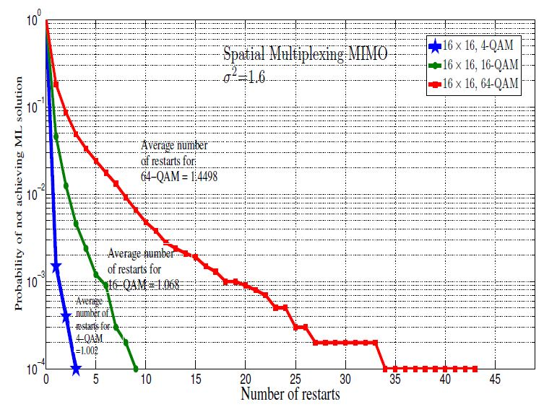
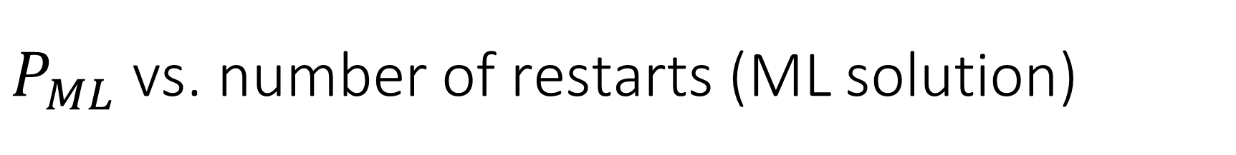
$P_{ML}$ vs. number of restarts (ML solution)
Image courtesy : T. Datta, A. Chockalingam, E. Viterbo, “Gaussian Sampling Based Lattice Decoding”

Slide 13
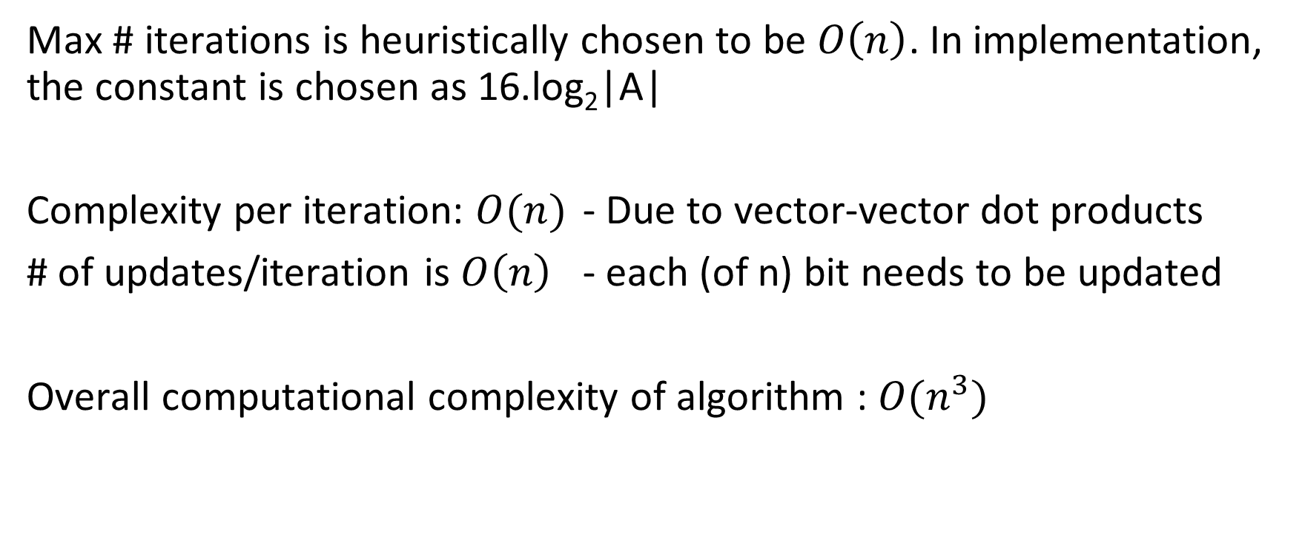
Complexity
Max # iterations is heuristically chosen to be $O\left(n\right)$. In implementation, the constant is chosen as 16.log₂|A|
Complexity per iteration: $O(n)$ - Due to vector-vector dot products
# of updates/iteration is $O\left(n\right)$ - each (of n) bit needs to be updated
Overall computational complexity of algorithm : $O(n^{3})$

Slide 14
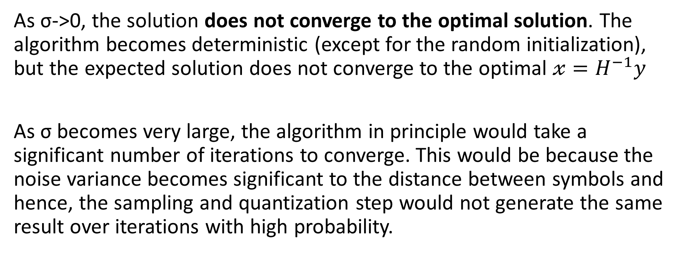
Convergence
As σ->0, the solution does not converge to the optimal solution. The algorithm becomes deterministic (except for the random initialization), but the expected solution does not converge to the optimal $𝓍=H^{−1}y$
As σ becomes very large, the algorithm in principle would take a significant number of iterations to converge. This would be because the noise variance becomes significant to the distance between symbols and hence, the sampling and quantization step would not generate the same result over iterations with high probability.

Slide 15
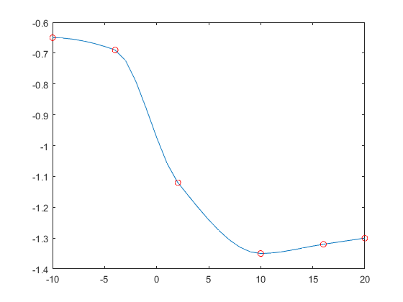
BER vs. SNR 16 x 16 16 QAM
Solution is non-optimal: hence it does not converge to the
X = H⁻¹y solution as σ -> 0
log₁₀(BER)
SNR ->

Slide 16
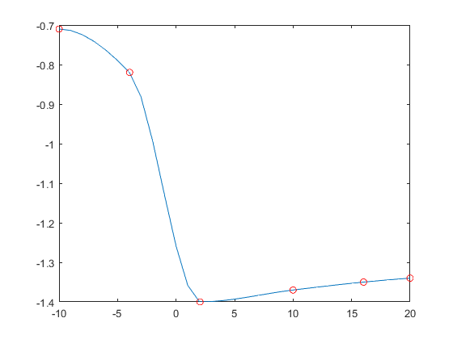
BER vs SNR 32 x 32 16 QAM
Solution is non-optimal: hence it does not converge to the
X = H⁻¹y solution as σ -> 0
log₁₀(BER)
SNR ->

Slide 17
Comparison with other models
Exact algorithms : ML decoding (Sphere decoder)[2].
Sub – optimal algorithms : K-best sphere decoding algorithm.
Fixed complexity sphere decoder
Randomized lattice decoding[Shuiyin et.al][4].
Other randomized algorithms [3].
[2]E. Viterbo and J. Boutros, “A universal lattice code decoder for fading channels,”
[3]T. Datta, N. A. Kumar, A. Chockalingam, and B. S. Rajan, “A novel MCMC algorithm for near-optimal detection in large-scale uplink multiuser MIMO systems,”
[4]S. Liu, C. Ling, and D. Stehle, “Randomized lattice decoding: Bridging the gap between lattice reduction and sphere decoding,”

Slide 18
Comparison with other models
Complexity :
ML Decoder(Sphere decoder) : Exponential Complexity. Not feasible for higher dimensions.

Slide 19
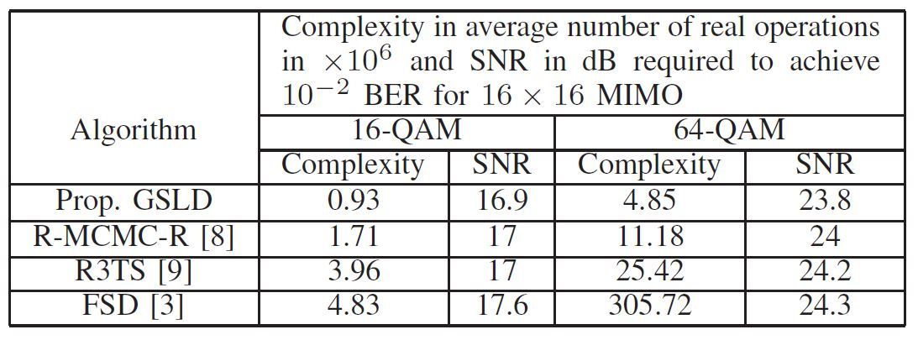
Comparison with other models
Complexity and SNR to achieve BER 0.01

Slide 20
Comparison with other models
Complexity and SNR to achieve BER 0.01
GSLD > R-MCMC > FSD

Slide 21
Comparison with other models
Performance:
ML Decoder > GSLD > R-MCMC > FSD

Slide 22
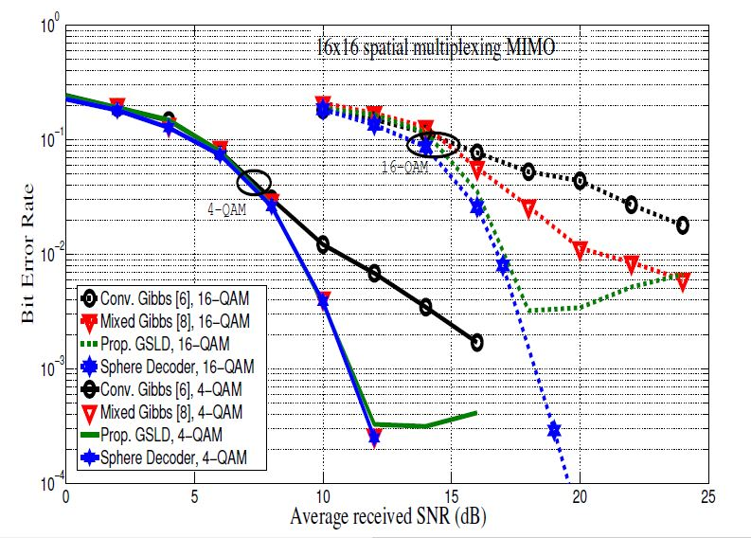
BER vs SNR curve for 4QAM and 16-QAM
Image courtesy : T. Datta, A. Chockalingam, E. Viterbo, “Gaussian Sampling Based Lattice Decoding”

Slide 23
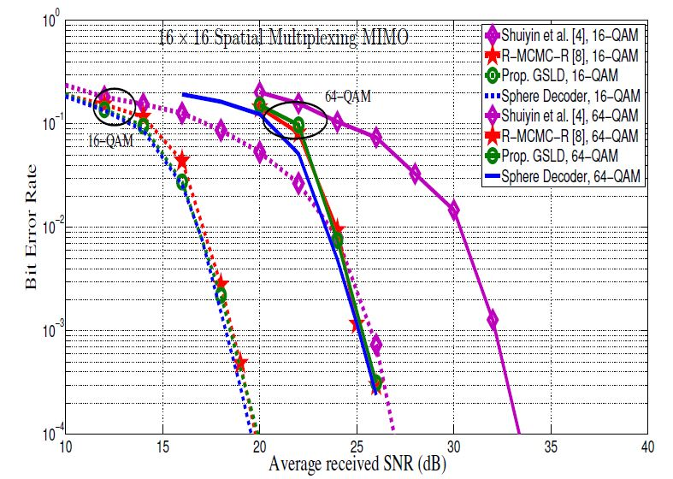
BER vs SNR curve for 16QAM and 64-QAM
Image courtesy : T. Datta, A. Chockalingam, E. Viterbo, “Gaussian Sampling Based Lattice Decoding”

Slide 24
Conclusion
The proposed GSLD performs competitively with the other existing models with much lower decoding complexity.
The algorithm is much easier to implement as compared to other lattice decoding algorithms

Slide 25
References
[1]T. Datta, A. Chockalingam, E. Viterbo, “Gaussian Sampling Based Lattice Decoding”
[2]E. Viterbo and J. Boutros, “A universal lattice code decoder for fading
channels,”
[3]T. Datta, N. A. Kumar, A. Chockalingam, and B. S. Rajan, “A novel
MCMC algorithm for near-optimal detection in large-scale uplink
multiuser MIMO systems,”
[4]S. Liu, C. Ling, and D. Stehle, “Randomized lattice decoding: Bridging
the gap between lattice reduction and sphere decoding,”

